Slide 1
SmartGuide: A smart campus guide using BLE based indoor localization
Submitted by:
Rida Mahmood 2016-CE-54
Tooba Naseer 2016-CE-72
Rabeya Hamood 2016-CE-81
Ayesha Jabbar 2016-CS-159
Project Advisor: Dr. Sheikh Faisal Rasheed
Department of Computer Engineering, UET LHR

Slide 2
Background
Outdoor localization has been formalized by using satellite-based technologies i.e. GPS, BeiDou , GLONASS , and GALILEO . It is hard for finding the indoor location by using conventional GPS technology because of no direct (Line of Sight) [4] in indoors, so we cannot use these technologies for indoor positioning. Up to date, the technologies used for indoor localization approach are: TOA (Time of Arrival), TDOA (Time Difference of Arrival), AOA (angle of arrival) but they have some limitations. TOA and TDOA require precise clock count and its synchronization and AOA-based systems require special antennas for their propagation.
PROBLEM STATEMENT
Whenever a visitor goes to university campus or visits a new place, he does not know about the specifications of that area i.e. what happens in that specific room or what courses have been taught in a particular and its nearby labs. So, we are developing a system which assists them in determining the textual and pictorial information of a particular area and its nearby locations. For this purpose, we first find the indoor location of a user by using BLE beacons and RSSI values, and then provide information to him automatically on his Android application.

Slide 3
OBJECTIVES
To find the indoor location of the user at room level and provide location information on his/her Android application. To monitor and provide guidelines to the user about his/her indoor location through his/her BLE enable Android application.
Implement a system that takes into account the demands of university campus exploration. This project leads to visitors of any organization or store to save their time and effort by providing them textual and pictorial information related to organization or store.
SCOPE
In this project, Android application runs on a user’s mobile device will capture BLE RSSI fingerprints. The fingerprints collected at the initial stage will be processed and used to train suitable machine learning model, after training of the ML based location prediction model, based on the room prediction relevant information of nearby rooms, facilities and personnel available will be prepared to be displayed to user at run time , the user will be guided to install our Android app on their phone, their mobile device will capture BLE fingerprints and the fingerprints will be sent to back end server where our trained model will predict their current location inside building in terms of room . The relevant information will be delivered and shown on user mobile device providing guided tour. The placement of Bluetooth low energy beacons will be held in CE dept at UET Lahore.

Slide 4
SOCIOECONOMIC BENEFITS
This project motivate us to provide ease and leverage facility to users so that they can see the information of a particular indoor environment on his mobile application automatically. BLE is available on nearly every smart device so no additional hardware required at user end. Hence by utilizing their indoor location determined using machine learning on BLE fingerprints, guided tours of smart campus to visitors can be provided and facilitating them. At economic point of view, this will be extremely beneficial not only in university campus but also in airports and shopping malls. Shopping malls can use this kind of application by providing much information to their customers in less time which automatically increases the sales and profits of their products.
COMMERCIALIZATION
Airport/Shopping malls assisting system
University campus smart information system
Government institutes smart guidance
Medical departments exploration in hospitals
Software house information (Development, QA, Frontier)

Slide 5
INNOVATION
Our selected algorithm is ANN whose explanation is provided in our thesis but as per dept instructions, we decided to make a try and proposed our own algorithm.
In our proposed algorithm we combine clustering and classification for better accuracy, firstly we use clustering to cluster the similar observations and then we train the classifier per cluster. Here, we choose random forest as our classifier per cluster. Suppose if we decided to make 4 clusters. Then we built 4 random forest classifier each for one cluster. When we want to predict an unseen instance, it will first assign to the closest cluster then the respective classifier gives its prediction.
One classifier trained per cluster will better learn the subset of data. It will also improve the accuracy of overall predictions on test data. If we train all classifiers for each cluster in parallel then training time might also be reduced.

Slide 6
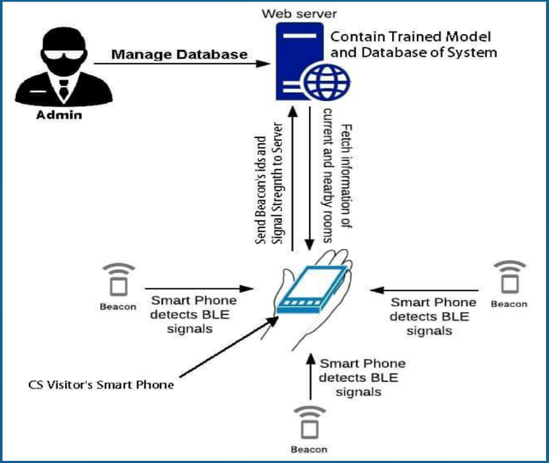
ARCHITECTURE DESIGN

Slide 7
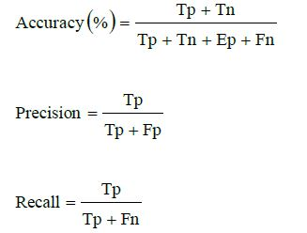
METHODOLOGY WITH MATHEMATICS
BLE- based Fingerprinting Technique
Machine Learning
Parameters Tuning for k-NN, Random Forest and ANN
Training by using these three algorithms
Detail Analysis
Selected Approach: ANN
Machine Learning Phases:
Dataset Pre-Processing
Training Phase and Testing Phase
Performance Evaluation Metrics
Other Subjects:
Android Application Development, Databases (For Database Design) , Programming Fundamentals, Software Engineering(For development of good quality system) and Networking (For understanding of interfacing with BLE beacons)

Slide 8
IMPLEMENTATION
Our proposed system has three Android applications.
Data Capturing Application:
Scanning of nearby BLE devices and capture RSSI fingerprints. Generate .csv files of captured data. Allow user to generate these files according to no of iterations and delay time provided by user.
Admin Android Application:
This Admin Application allows admin to Add/Edit/Del information related to locations.
This information is stored in database and the database is connected with admin application.
User Android Application:
This User Application provides guidance to the users. It displays the location of user and shows all information related to current room and nearby rooms. Also update the location of the user after some time interval.

Slide 9
Tools
To develop this proposed system, we use following tools to implement this system:
Android 3.5 or above with java
Php, MySQL
Php Storm
Python IDE (Spyder)
Python ML platform (Anaconda)
Postman
MATLAB

Slide 10
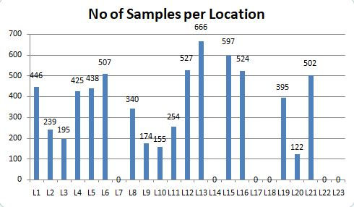
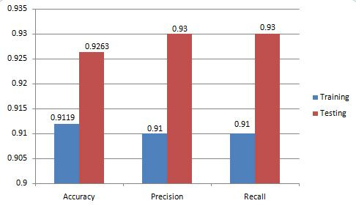
RESULTS
Number of collected samples per location shown here:
ANN outperforms KNN and random forest. Here is the ANN performance graph:

Slide 11
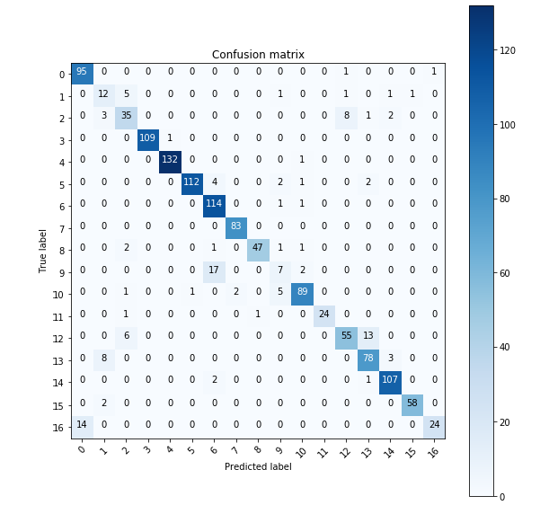
DISCUSSION
Here is the confusion matrix for ANN.
Our results shows that ANN gives better performance as compared to others because usually deep learning performs better on this type of data.
We use the fingerprinting technique that collects BLE beacons fingerprints and apply ML algo on it.
Our system predicts the indoor location with 92.63% accuracy which is better than existing systems that predicts indoor locations with older technologies.
Hence fingerprinting approach used with BLE beacons is the most suitable approach for indoor localization.

Slide 12
Conclusion & future work(Commercialization aspect)
We developed an Android application for our CE department, UET Lahore. But in future we will make this application for whole university.
In airports, where we have to give information of waiting, luggage, canteen areas to the passengers through this application.
In hospitals, where a patient or his partner wants to know about emergency, integrated care units, medical testing areas and much more. This kind of application will lead them to their destination.
We can implement this system into the shopping malls, so that users finds products and things easily. Due to this shopping mall also gets huge benefit in the terms of sales and profit.
We can also aware system users to find the place using indoor map of building where they want to go, this will lead to possible extensibility of our project in future.

